Slide 1
DSLS 2023 Mini Project DA: Case Study
Hendri Darmawan
hendridarmawan512@gmail.com

Slide 2
Business Understanding
Problem Statement: Traffic jams occur due to recurring and non-recurring factors such as a lack of enough road capacity, accidents, construction zones, and inclement weather conditions. Traffic jams can lead to significant economic costs and air quality problems in cities.
Use Case Dashboard: This dashboard can be utilized to analyze the traffic condition, particularly congestion in the city of Banjar. It includes two charts. The first chart is a time series graph that displays the levels, median delay, and median speed. The second chart is a bar chart that allows users to observe incidents in a specific location based on the selected location and date filters.
The dashboard can be used by various individuals and organizations who are interested in analyzing traffic conditions and congestion in the city of Banjar. Some potential users include traffic engineers, city planners, transportation researchers, local government officials, and law enforcement agencies.

Slide 3
Business Understanding
Problem Statement: Traffic jams occur due to recurring and non-recurring factors such as a lack of enough road capacity, accidents, construction zones, and inclement weather conditions. Traffic jams can lead to significant economic costs and air quality problems in cities.
Use Case Dashboard: This dashboard can be utilized to analyze the traffic condition, particularly congestion in the city of Banjar. It includes two charts. The first chart is a time series graph that displays the levels, median delay, and median speed. The second chart is a bar chart that allows users to observe incidents in a specific location based on the selected location and date filters.
The dashboard can be used by various individuals and organizations who are interested in analyzing traffic conditions and congestion in the city of Banjar. Some potential users include traffic engineers, city planners, transportation researchers, local government officials, and law enforcement agencies.

Slide 4

Dashboard Identification
In data visualization, the ability to filter data based on specific criteria is crucial for gaining valuable insights. One common example of this is the use of dropdown menus to filter data based on selected street and date ranges. This allows the viewer to focus on specific segments of data that are of interest or relevance to their analysis.

Slide 5
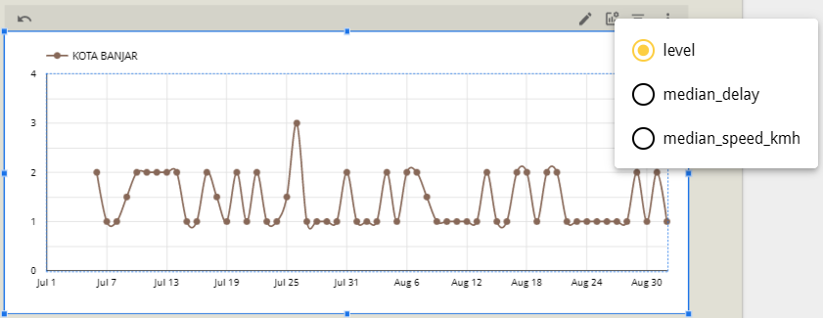
Dashboard Identification
Time series charts are an invaluable tool for analyzing trends and patterns over time. In the case of analyzing traffic conditions, using a time series chart with median data allows for a more in-depth understanding of how traffic patterns change on different dates. This type of chart is particularly useful in identifying any significant anomalies or unexpected events that may have occurred during a particular time frame. By monitoring the time series data, transportation planners and engineers can make data-driven decisions about how to optimize traffic flow, reduce congestion, and improve safety on the roads.

Slide 6
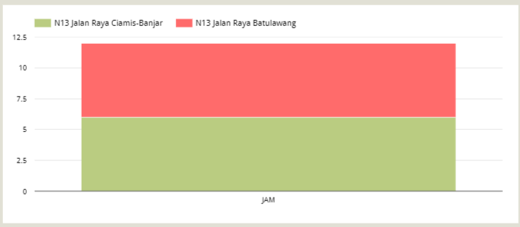
Dashboard Identification
Bar charts are a powerful data visualization tool that can be used to gain insights into discrete events or alerts that have occurred within a specific time frame. By applying filters to the data, analysts can examine how many incidents have been associated with a particular condition or event, such as accidents or adverse weather.
Bar chart can be used to visualize the frequency and severity of these incidents over time. This data can then be used to identify any underlying causes or contributing factors, such as poor road conditions or inadequate signage.

Slide 7
Thank You

